Slide 1
Emotion Detection Model on Twitter

Slide 2
Meet the Team
Deena Aljarallah
Junior Data Scientist @Global Digital Mojo
Mariam Alsaeed
Bioinformatician Researcher
@ KACST
Ahmad Alshehri
Business Performance Specialist @ Sabic
Arwa Alamoudi
Lecturer in Software Engineering @ KSU
Kholoud Almutairi
Retail Risk MIS and Credit Analyst @ ENBD

Slide 3
The Problem
1

Slide 4
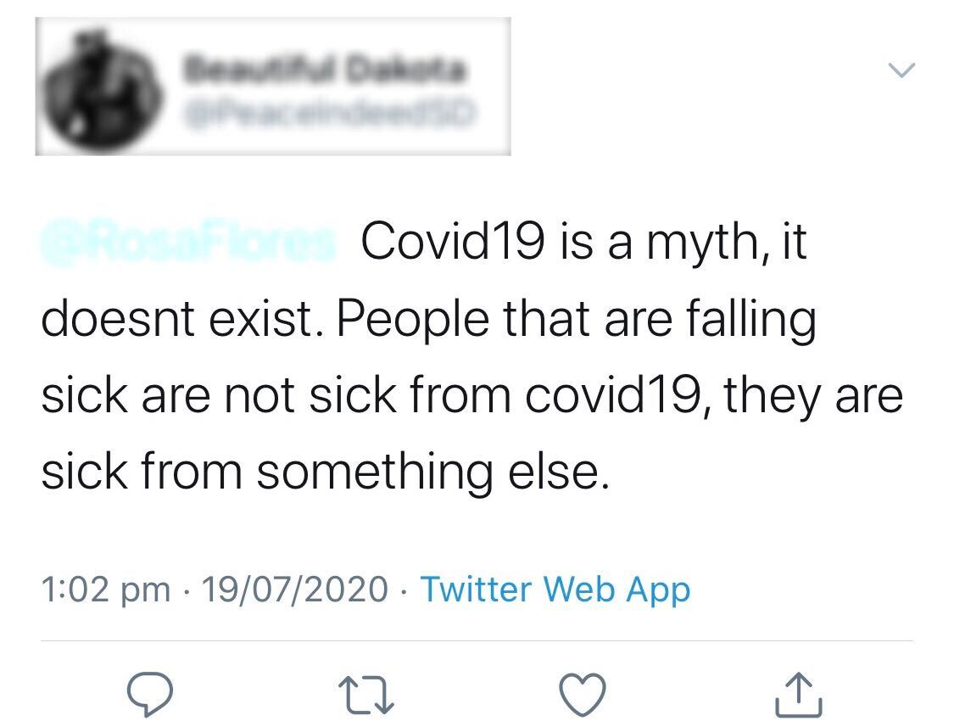
Covid-19, is it a Myth or Fact?

Slide 5
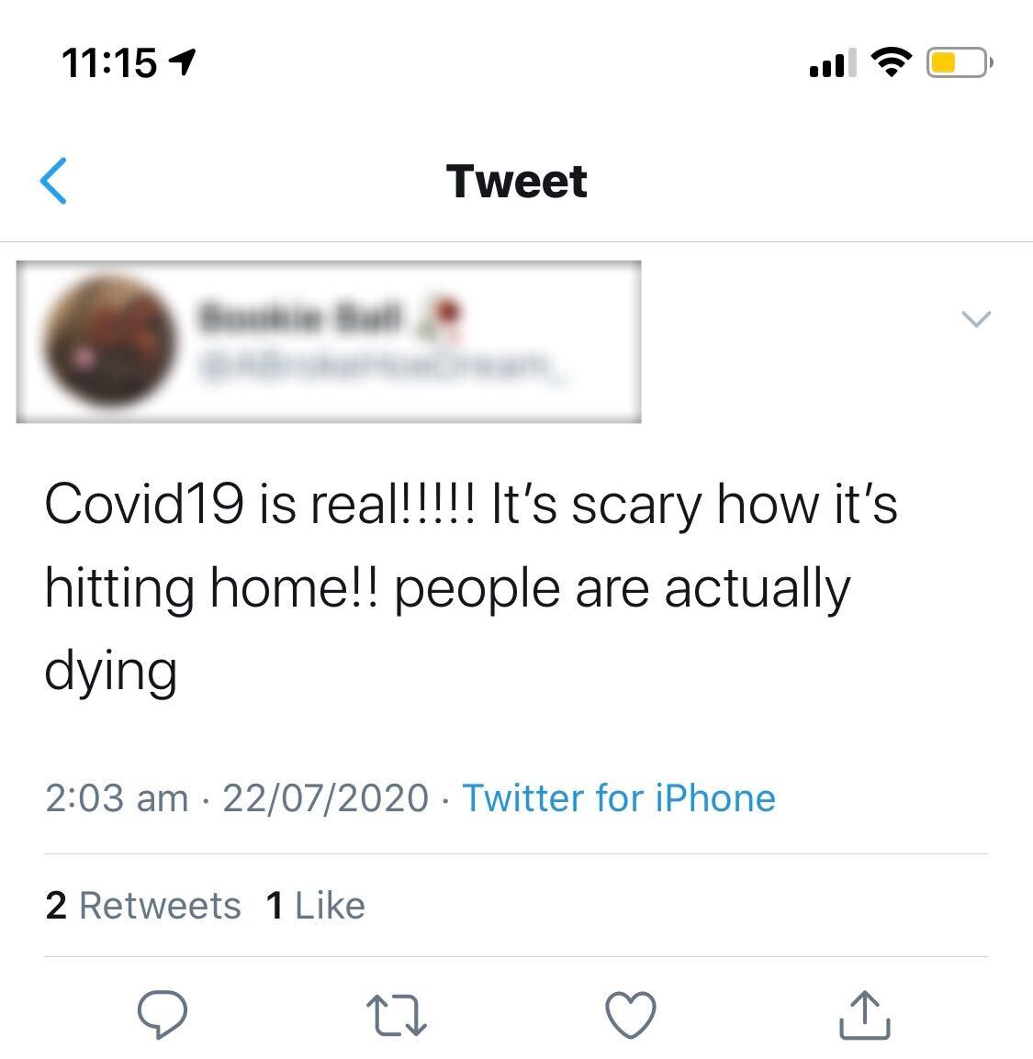
Covid-19, is it a Myth or Fact?

Slide 6
Problem Statement
11th March 2020: WHO announced COVID19 outbreak as a pandemic.
Starting from China, this virus has infected and killed thousands of people from Italy, Spain, USA, Iran and other European countries as well.
A number of countries have resorted to complete lockdown.
During this lockdown, people have taken social networks to express their feelings and find a way to calm themselves down.
However, In the midst of a global pandemic, some people are denying the existence of the pandemic.
In this research work, country wise sentiment analysis of the tweets has been done.
Notes:
These tweets are related to COVID19 in some or the other way. This analysis has been done to analyse how the citizens of different countries and languages are dealing with the situation. The tweets have been collected, pre-processed, and then used for text mining and sentiment analysis. The results of the study concludes that while majority of the people throughout the world believed in the presence of this virus and taking a positive and hopeful approach, there are instances of fear, sadness and disgust exhibited worldwide.

Slide 7
The Solution
2

Slide 8
Dataset
The dataset was taken from kaggle.
It contains tweets that have the following hashtags: #coronavirus, #coronavirusoutbreak, #coronavirusPandemic, #covid19, #covid_19, #epitwitter, #ihavecorona, #StayHomeStaySafe, #TestTraceIsolate
As a proof of concept we focused on April 30th tweets.
Notes:
The dataset was in 30 of april which is first months to COVID-19 to spread around the world , it was include a lot of hashtags and links and emojis. these tweets and include different opinions and feelings and stories about the virus.

Slide 9
The Solution
Cleaning and formatting the global tweets so that it can be easily analyzed.
Translating any non English tweets about COVID-19 virus to be involved in the analysis.
Applying NLP algorithm to analyze the emotions and panic around the world.
Notes:
To understand the public reaction about COVID-19, we need to apply NLP processing on tweets, to know and translate their what people think about virus in the world, if they believe it or not, the size of the pandemic. Analysis can help governments and countries to decide how to control instructions and if people follow it or not.

Slide 10
Demo
3

Slide 11

People Emotions about Covid-19
Notes:
This figure shows people emotions on April 30th about covid-19. As shown, Fear was the most dominant feeling, around 50% of the people. Then Joy with around 25% of the people. Surprise with a total of 24. Then, sadness, disgust and anger.
The figure is interactive, one can uncheck the unneeded feelings and focus on the others.
From this figure, we can say that a lot of people think that covid-19 is a fact and not a myth.

Slide 12
People’s Response Towards others Tweets
Notes:
This figure shows the total number of likes for each feeling, so it appears that the tweets with “Fear” feeling got the most likes (86,449,602). Then Joy, surprise and other feeling.
The result in this figure confirms to the figure in the previous slide. This may mean that people can influence others through the tweets.

Slide 13
Remaining demos ...

Slide 14
Scalability and
Call to Action
4

Slide 15
Scalability & Call to Action
Real time emotion analysis on people’s tweets through Twitter API.
Detects the emotions of people in specific country.
Run the script in a cloud service over a big dataset.
Notes:
The work done in this research was a proof of concept that people emotions tell a lot of things and through analysing these emotions we can understand people’s opinion toward different things such as government rules and actions in response to covid-19.

Slide 16
THANKS!

Slide 17
Credits
Colnerič, N., & Demšar, J. (2018). Emotion Recognition on Twitter: Comparative Study and Training a Unison Model. IEEE Transactions on Affective Computing, PP (99), 1. https://doi.org/10.1109/TAFFC.2018.2807817
https://www.kaggle.com/smid80/coronavirus-covid19-tweets-late-april?select=2020-04-30+Coronavirus+Tweets.CSV
Translation done using googletrans · PyPI
Presentation template by SlidesCarnival & Powtoon

